Slide 1
Using Community Tools to Get Onboard with Apple's DEP-based Mac Deployment
Spring Lake Park Schools
macOS Provisioning Process

Slide 2

Scripting to the Last Mile
Brandon Taitt
Technology Support Specialist II
Spring Lake Park Schools
btaitt@district16.org
MacAdmins Slack: @btaitt

Slide 3
Before Provisioning
We have ~1000 Macs (primarily non-T2 MacBook Airs)
Half are issued to staff, used 1:1
The rest are student MacBook carts, two iMac labs, sub/guest teacher MacBooks
We had a range of macOS versions (10.10-10.14) running across our fleet
Last major “imaging” project was 2016
Bound to Active Directory with mobile accounts
No FileVault (see above)
Staff were admins on machines
Results: adware, out-of-date software, compatibility issues, security concerns

Slide 4

It’s time to get onboard…

Slide 5
Testing and Prep
Initial testing done within tech dept. Dec. 2018, eventually rolled out to pilot group
Started with custom scripts, didn’t use NoLo initially
Worked well for a time but after the Jamf purchase of Orchard & Grove and release of their own DEP Notify starter script, decided to leverage their tools
Notes:
I realized that, if Jamf is buying this company and building their own script, it's likely a ma tter of time to when they build this into the product. My hope is leveraging their tools will make an eventual transition to a native onboarding solution easier.
A lot of this took buy-in from admin, teachers, and ed services. People don't like getting wiped.

Slide 6
The tools you need
Leveraging community tools can get you there
NOTE: All of this assumes you’re using an MDM. MDM is required to manage Apple Devices, period.
After Setup Assistant…
  InitialConfig Enrollment Policy (Johan McGwire’s enrollment kickstart)
  NoMAD Login AD replaces macOS login window
    Configured via script
    Others use config profile. Script happens to be more reliable for us.
  DEP Notify runs policies, installs apps
    Configured via Jamf’s DEPNotify-Starter script (with some customization)
  Configuration profiles
    Custom app settings (NoMAD, Office), wi-fi, PPPC profiles, etc.
    FileVault and individual key escrow to Jamf
  Logout
Notes:
We went with custom scripts for a while, but at some point, you need to not thing about Mac Deployment (Nate Strauss quote). My hope is that showing you how leveraging community tools can get you on board now, and from there you can develop more customized skills and tools for deployment.

Slide 7
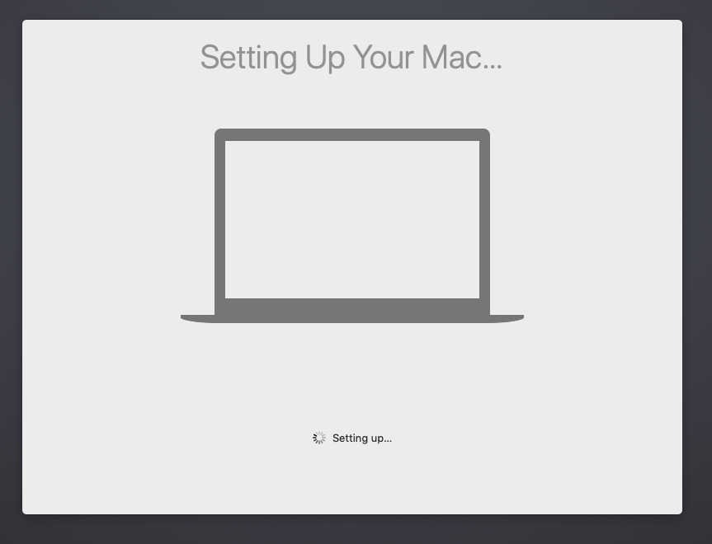

Login
Jamf PreStage
Local admin created
Authenticate via LDAP but do not create local user
Stops at login window
InitialConfig
Installs via enrollment trigger
Kicks off NoLo and DEP Notify
NoMAD Login AD
Triggered via InitialConfig
Login with local user

Slide 8
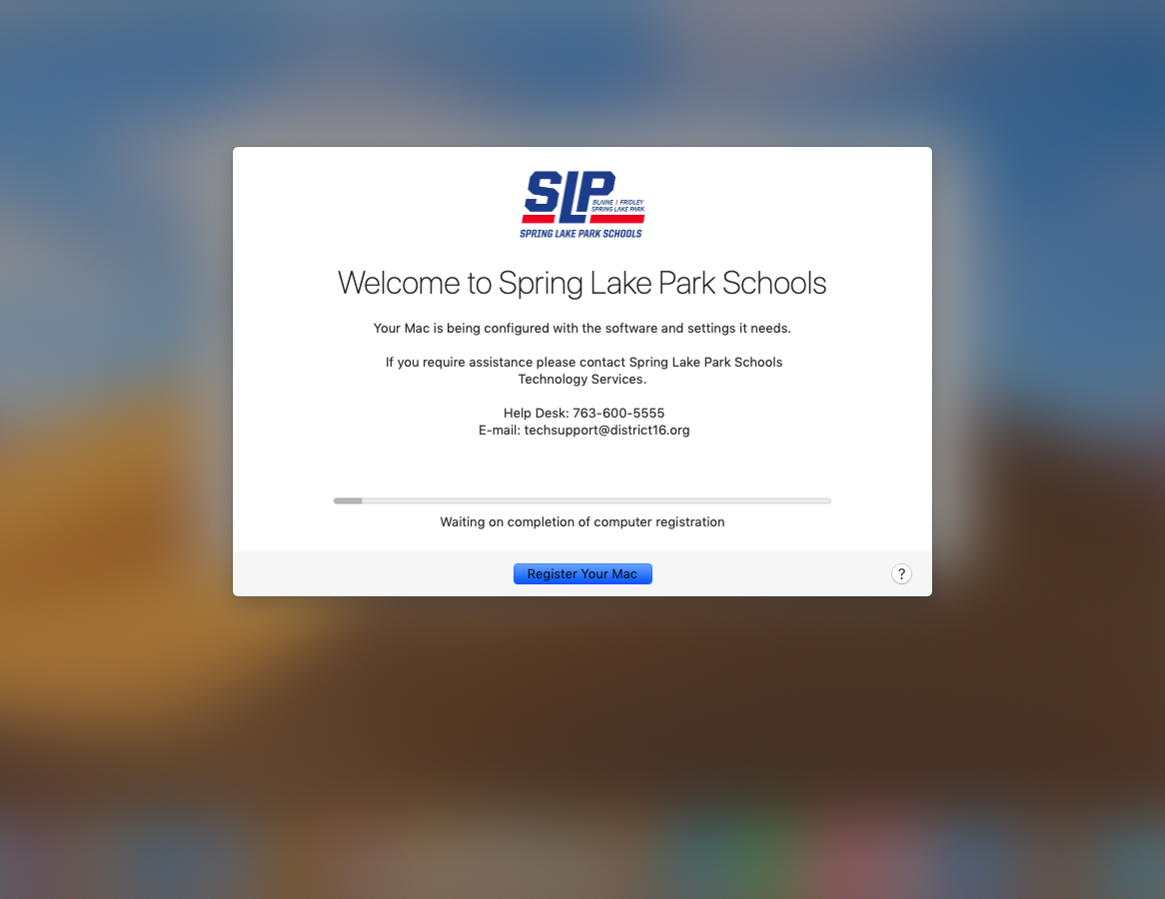
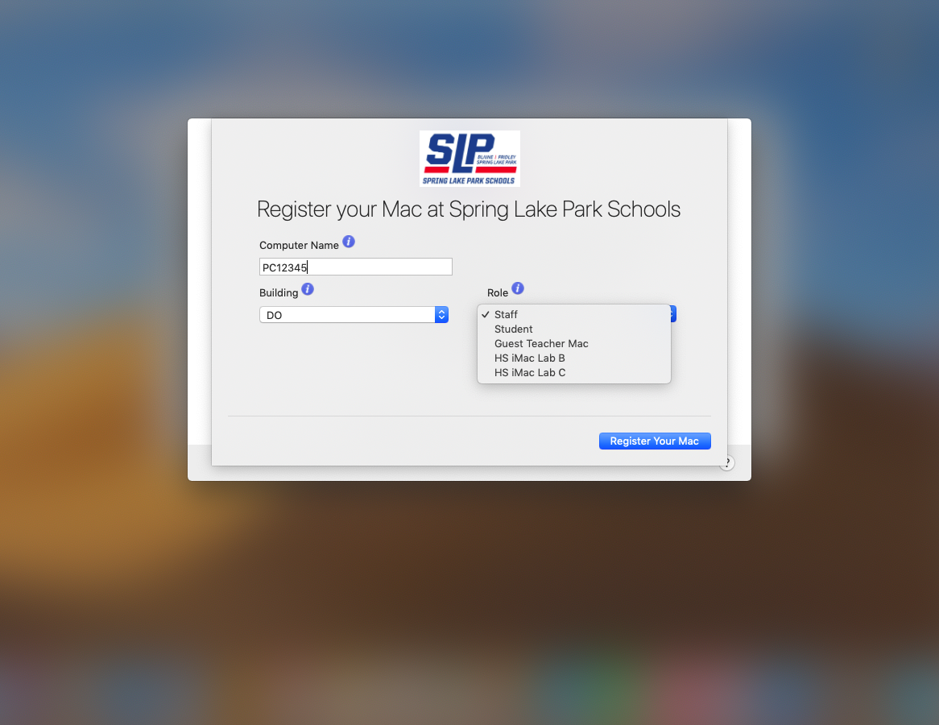
Configure
DEP Notify
Installed via InitialConfig
Configured via Jamf script
Mac is registered with computer name, building, and role. All three values mapped to User & Location extension attributes in Jamf
Notes:
By using the departments as a role, and using smart groups, we actually don't care what the computer is called anymore. We used to scope based on name, but that caused its own headaches.

Slide 9
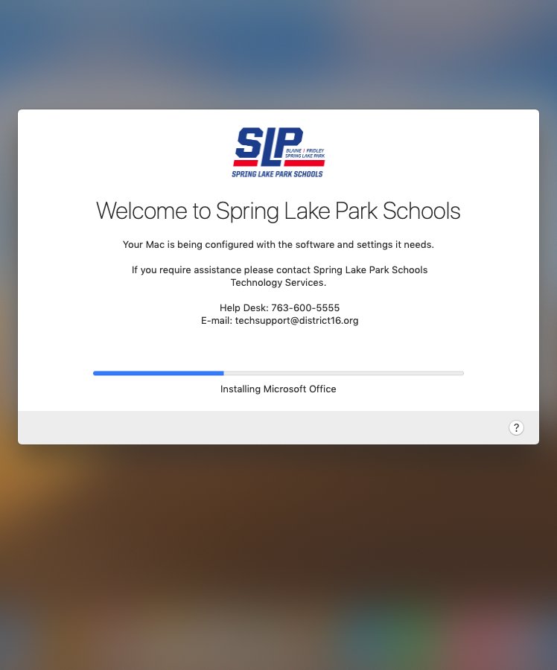
Install
Apps installed via policies triggered by Jamf script
  Role value determines which Macs run which policy
  Ex. Staff Macs get FileVault profile, PaperCut, Google Drive. iMac Labs get Adobe but not FileVault, etc.
Jamf config profiles are also installing
Logout for staff Macs (to initiate FileVault), other Macs reboot
Notes:
Takes about 15-20 minutes

Slide 10
InitialConfig
https://github.com/Yohan460/JAMF-Enrollment-Kickstart
Jamf enrollment trigger is… sensitive.
  A network state change or hiccup can kill a chain of policies triggered by the EnrollmentComplete trigger in Jamf
InitialConfig runs off the EnrollmentComplete trigger
  Installs a launch agent to run scripts set to use policies configured with a customer trigger of “InitialConfig”
  Custom triggers *are* reliable
After InitialConfig runs, we install NoLo and DEP Notify with InitialConfig triggers
You can run multiple policies in numeric order (00, 01, 02, etc.)
A final policy ends InitialConfig and deletes the launch agent

Slide 11
NoMAD Login AD
https://nomad.menu
Replaces macOS login window with custom branded login
Creates local account based on AD credentials
Allows shared Macs to be logged into by anyone without AD bind
Passes credentials to NoMAD and logs it in automatically
Package created using Jamf Composer, installed through policy, configured with script
Installed in our own /var/slp/ folder, includes bundle and custom logos

Slide 12
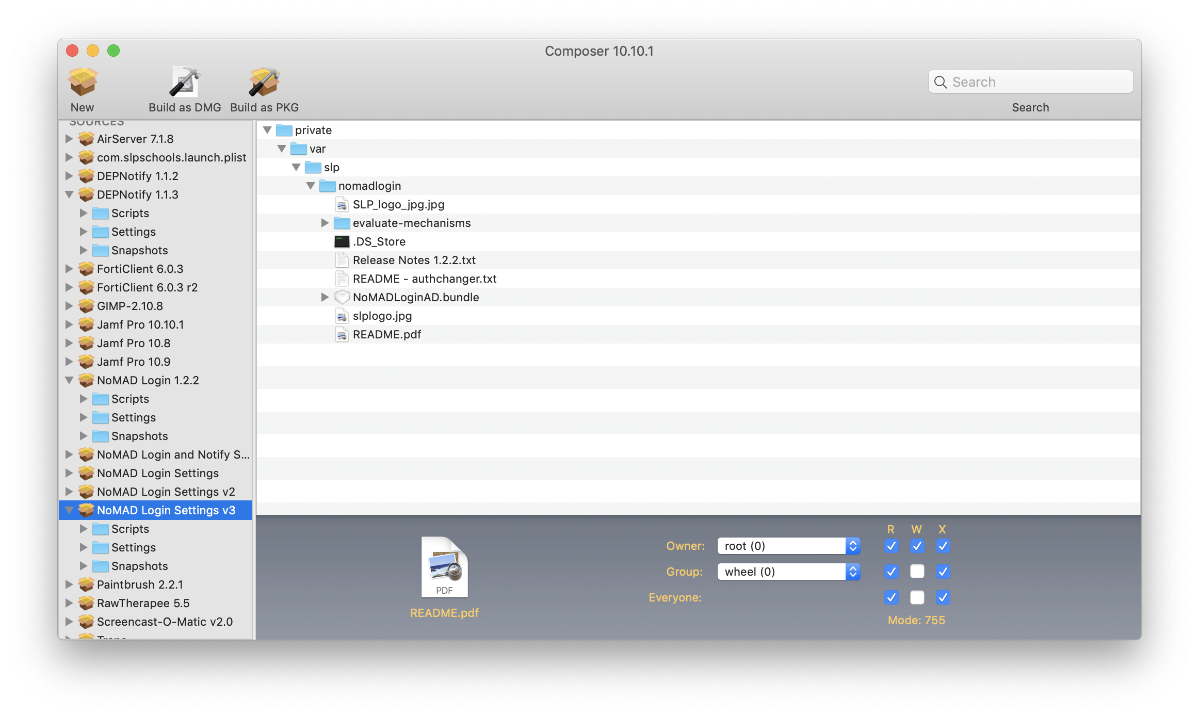
NoMAD Login AD

Slide 13
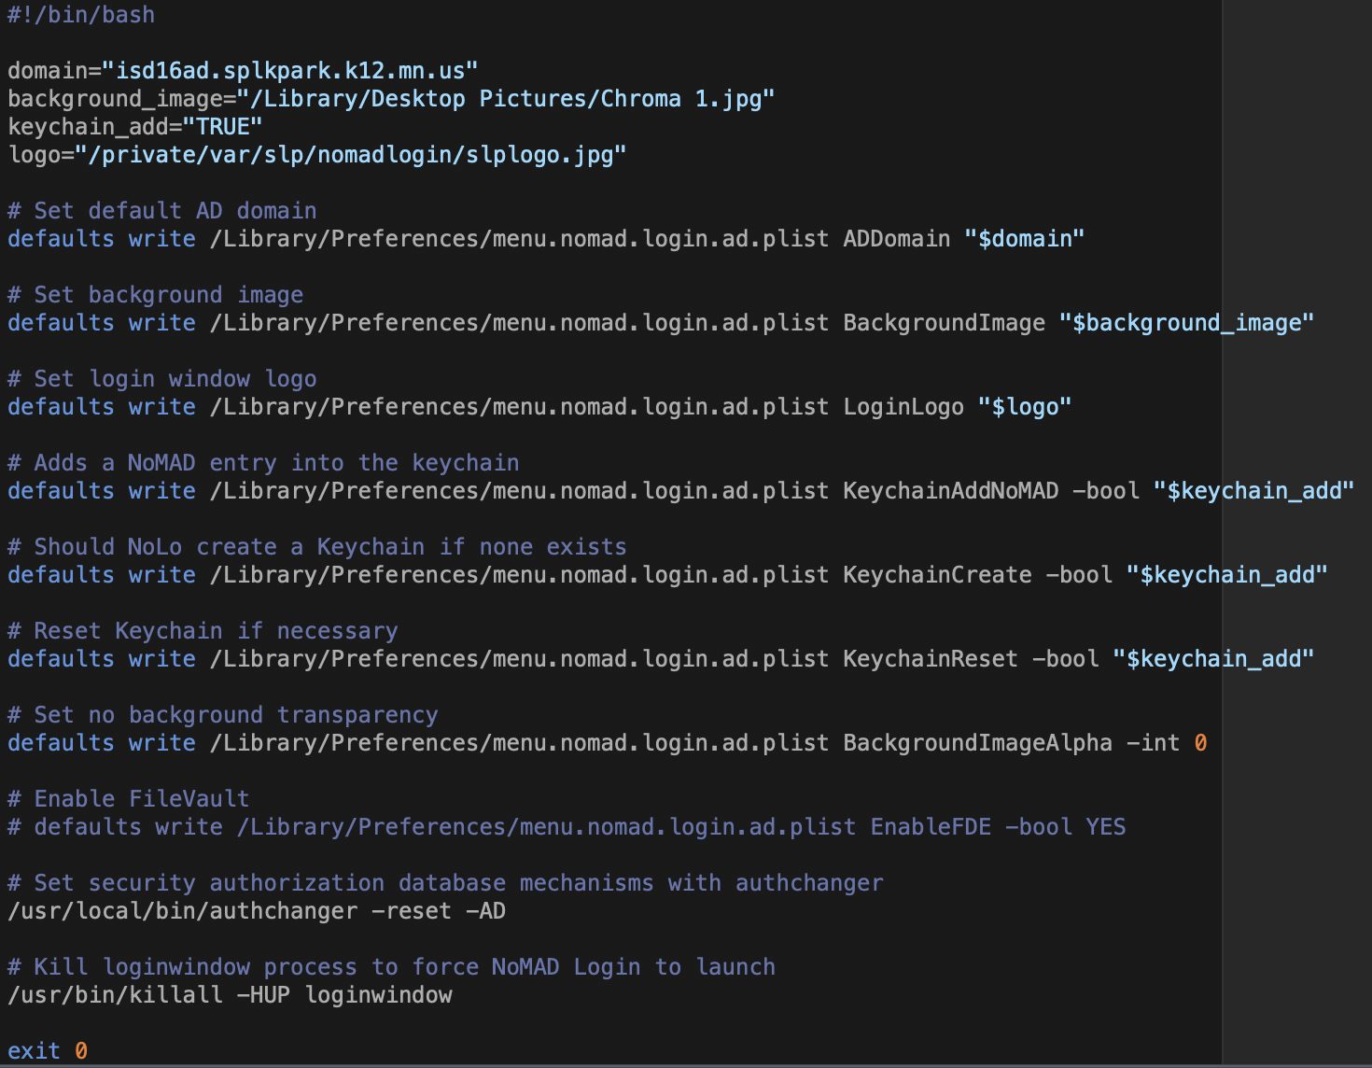
NoMAD Login AD

Slide 14
DEP Notify
https://gitlab.com/Mactroll/DEPNotify
InitialConfig-triggered policy runs
  Includes pkg for DEP Notify and customized Jamf starter configuration script
Important parts to modify are:
  Custom branding and text
  Registration fields
    Computer Name
    Building
    Role
  Policy array (pre-installed apps, policies, and more)
  EULA (we don’t use this, but you sure can!)
Use testing mode!

Slide 15
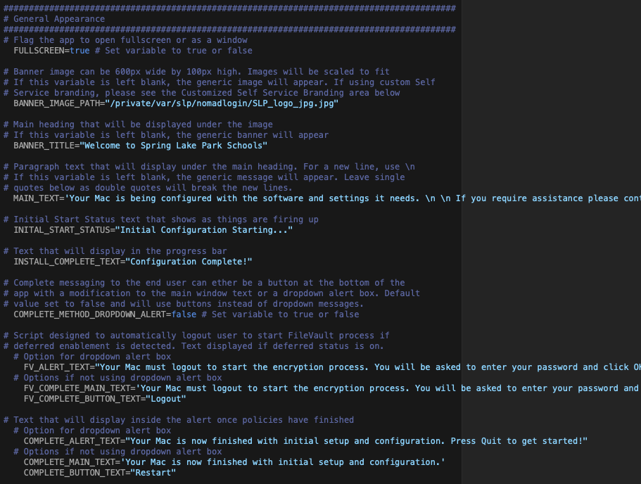
DEP Notify – Branding and FV Settings

Slide 16
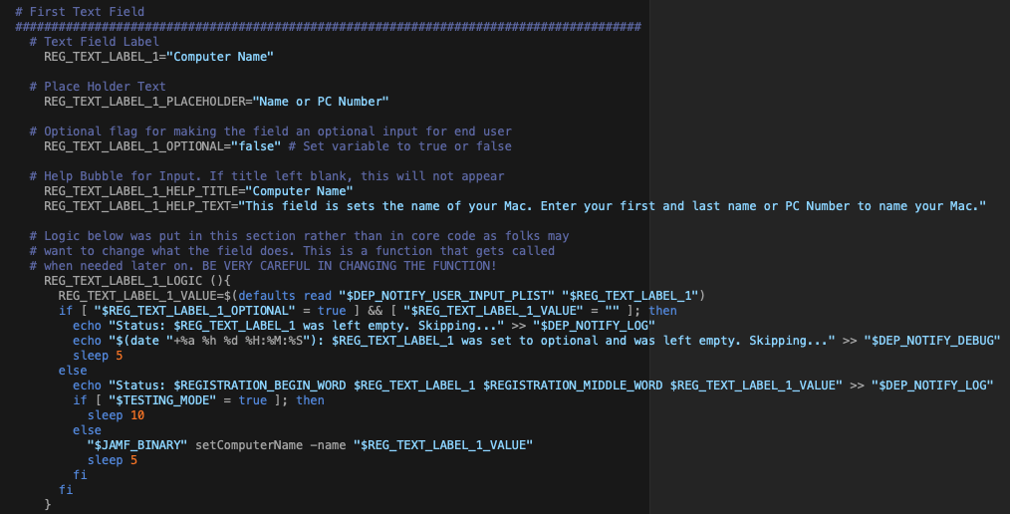
DEP Notify - Name

Slide 17
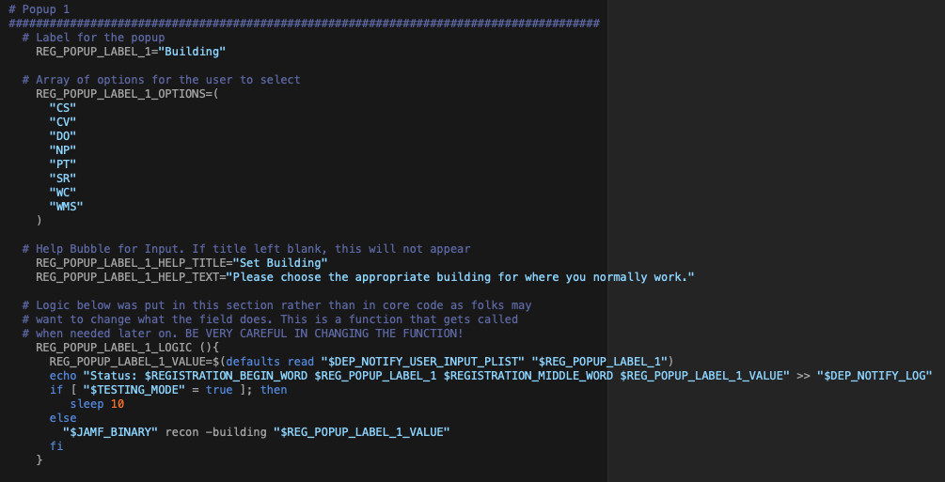
DEP Notify – Building and Role

Slide 18
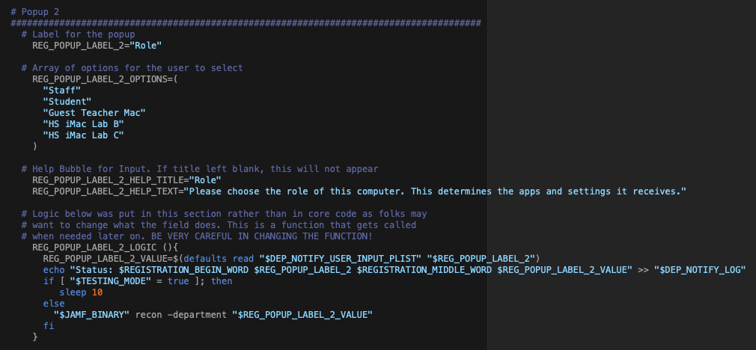
DEP Notify – Building and Role

Slide 19
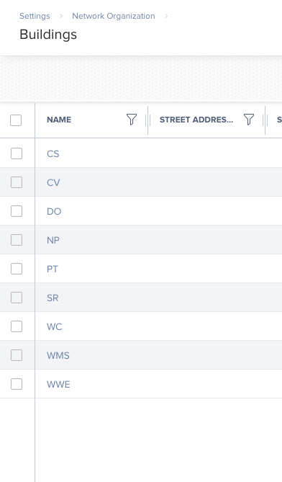
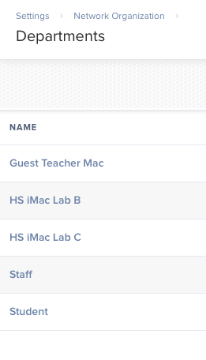
DEP Notify – Building and Role
Building options mapped to same values in Jamf
“Role” is mapped to Department in Jamf, same values must be set

Slide 20
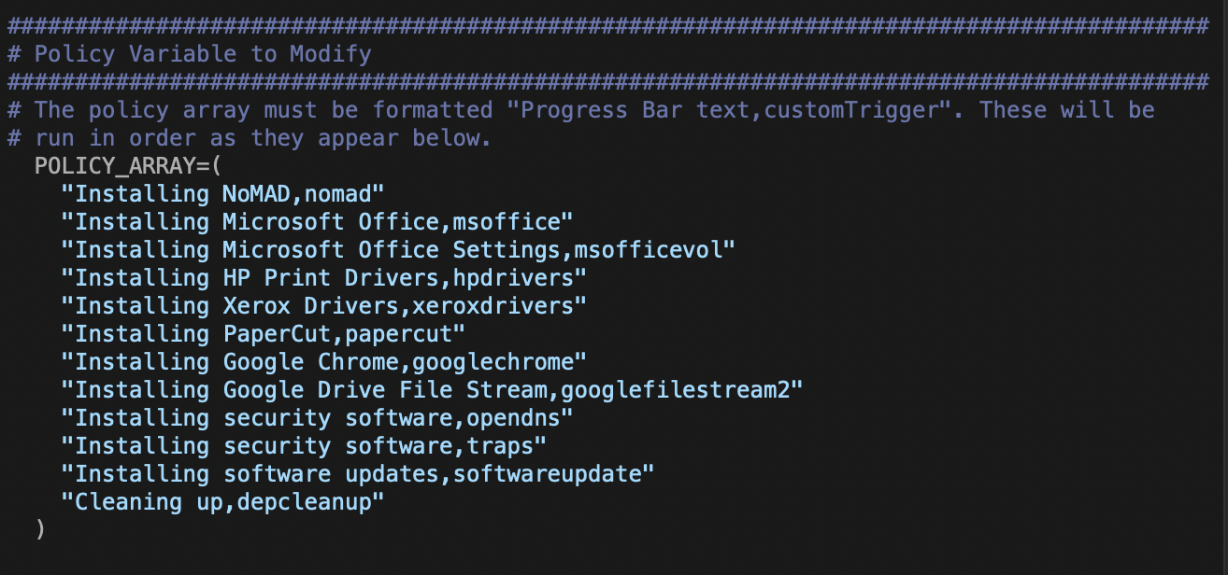
DEP Notify – Policy Array
This is where you run your policies based on custom triggers
Policies mapped by smart groups based on department/role

Slide 21
Configuration Profiles
Configuration Profiles are used to configure system settings, app settings, and more.
Examples of our default config profiles include:
  New to macOS Catalina: App Notifications profiles
  PPPC Profiles for browsers, Microsoft Office, and more
  FileVault
  Power settings
  Configuration of Office 365 and Outlook (ex: auto-filling user’s email for Outlook setup)
Increasingly taking the place of scripts.

Slide 22
Configuration Profiles
ProfileCreator used to create may profiles
https://github.com/ProfileCreator/ProfileCreator (also #profile-creator on MacAdmins Slack)
Recommend signing up for an Apple Enterprise Developer account to be able to sign profiles. Cost: $300/year
  Prevents MDM from modifying profile
  Apple accepts profile coming from MDM signed with Apple cert

Slide 23
2019 Updates – Final Result
All Macs are now…
  macOS Mojave 10.14.6 (testing on 10.15)
  Everyone, including staff (and techs!), are standard accounts
  FileVault enabled for staff
  Not bound to AD
  Leverage NoMAD Login AD (aka NoLo) and NoMAD for authentication/Kerberos
Notes:
Our hope is by getting everyone on the same platform, leveraging Apple and Jamf's better tools for deploying updates, we can prevent future mass update projects - same as our iPads.

Slide 24
Future improvements
Finer control over policies based on computer role
FileVault deployment not working in Catalina – likely Jamf/Apple bug
Handful of machines sometimes will not write name/role to Jamf until reboot or not at all
Non-T2 devices will skip all of this if there’s no network
Small issues above don’t quite get us to “Post-It note” status quite yet, techs guide this process to onboard staff right now

Slide 25
Links
  InitialConfig Enrollment Policy (Johan McGwire’s enrollment kickstart)
    @Yohan on MacAdmins Slack
    https://github.com/Yohan460/JAMF-Enrollment-Kickstart
  NoMAD Login AD
    https://nomad.menu
  DEP Notify
    https://gitlab.com/Mactroll/DEPNotify
  Profile Manager
    https://github.com/ProfileCreator/ProfileCreator
  This slide deck available on Brainstorm’s site.
Notes:
We went with custom scripts for a while, but at some point, you need to not thing about Mac Deployment (Nate Strauss quote). My hope is that showing you how leveraging community tools can get you on board now, and from there you can develop more customized skills and tools for deployment.

